Slide 1
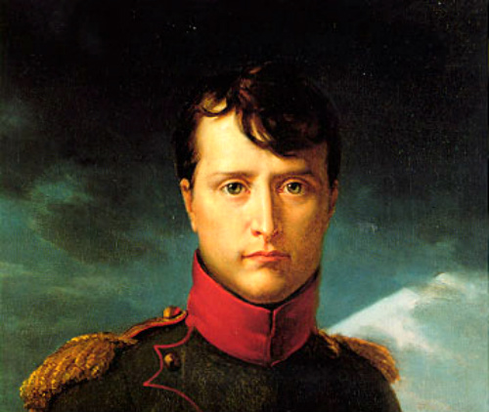
Napoleon Bonaparte: His Fall and the 100 Days Told in the perspective of Napoleon Himself
Through accounts of historians
as well as the emperor himself
In his journal entries
By:
PolinA davydov
Napoleon Bonaparte
Courtesy of Google Images

Slide 2
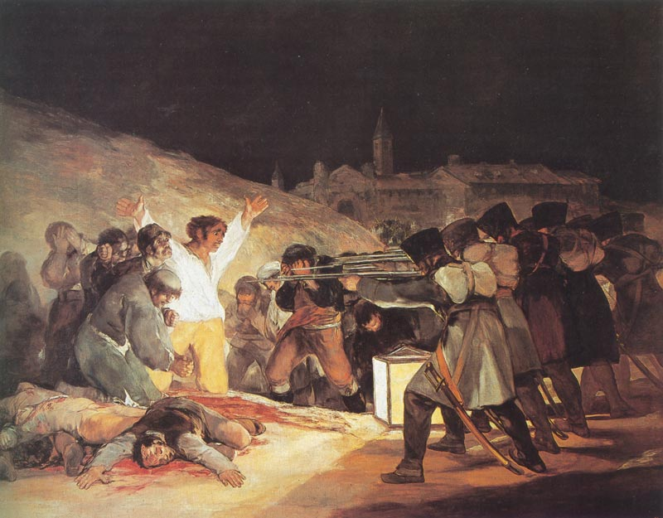
What Started it All… “The Spanish Ulcer” (1808-1814)
With me as a crowned emperor and my Grand Army conquering much of Europe, I saw Spain as my next great conquest
I used my wits to trick and imprison Spanish king and proclaimed my brother, Joseph, to be the new king of Spain
Local rulers formed juntas to maintain power
On May 2, 1808 [Dos de Mayo] the Spanish rose up in rebellion
Our troops fired on the crowd in Madrid the next day [Tres de Mayo].
“Tres de Mayo”
By Goya
Courtesy of Google Images

Slide 3
A Brief Look at My Work in Spain
Courtesy of Google Images
Video: www.youtube.com/watch?v=EnRhAga9tuE

Slide 4
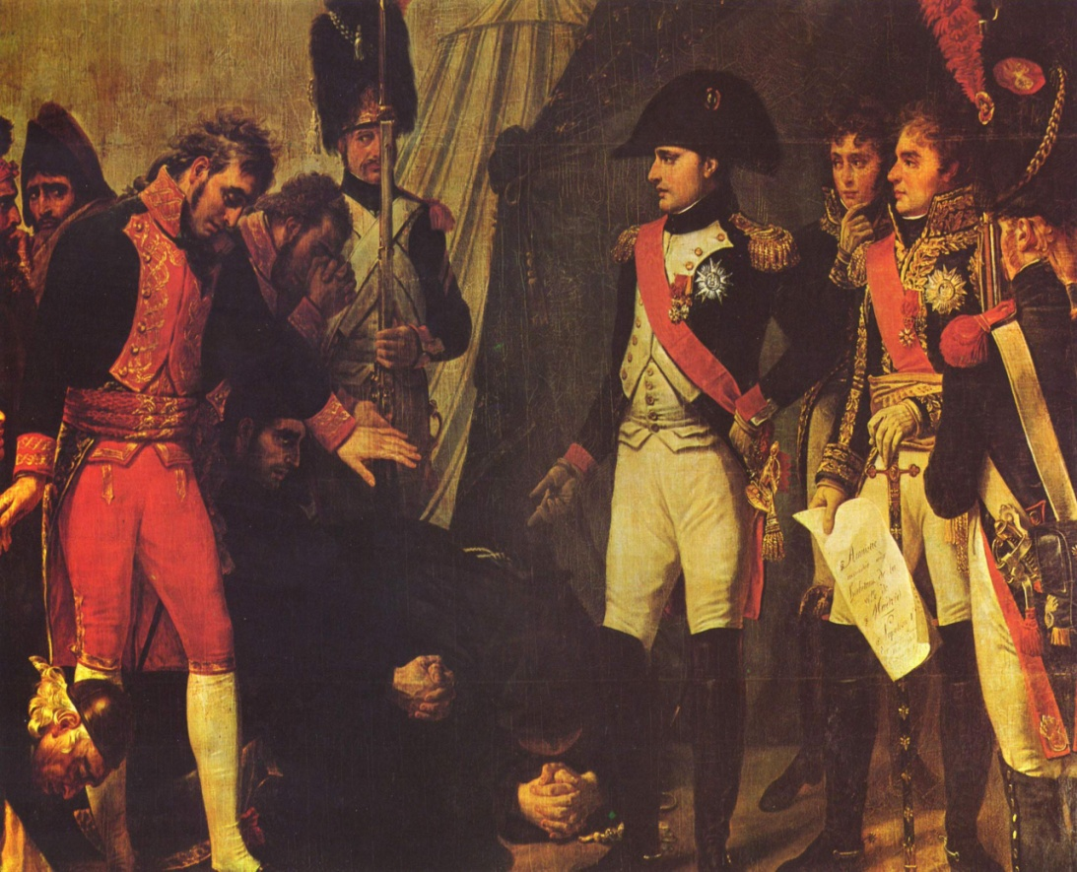
I poured my 500,00 troops into Spain over the next few years Unfortunately some of the French generals had trouble subduing the pesky Spanish rebels The British had viewed this uprising as an opportunity to weaken me They moved an army into Portugal to protect that country and to aid the Spanish guerillas After 5 long years of savage fighting, our troops were finally pushed back across the Pyrennes Mountains out of Spain
Problems With Spain Begin to Arise
Me at the Surrender of Madrid May, 1809
By Goya
Courtesy of Google Images

Slide 5
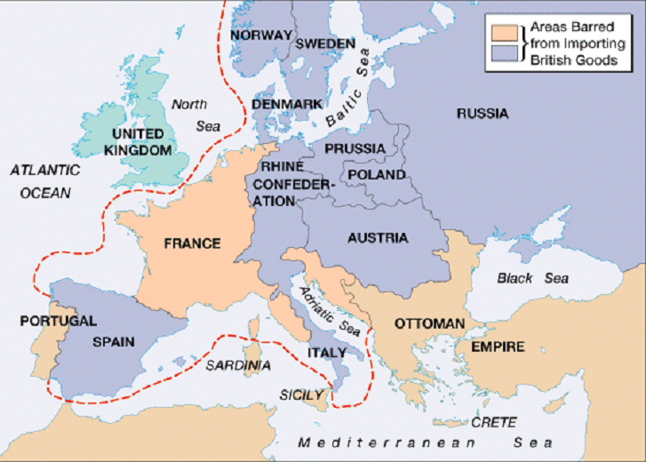
At the same time…
Napoleon problem’s in the French State:
Many Europeans hated the Continental System that I created
Continental System: also known as Continental Blockade, the foreign policy mine which brought into effect a large-scale embargo against British trade
Revolutionary ideals of self-government spurred nationalism in conquered states
Courtesy of Google Images

Slide 6
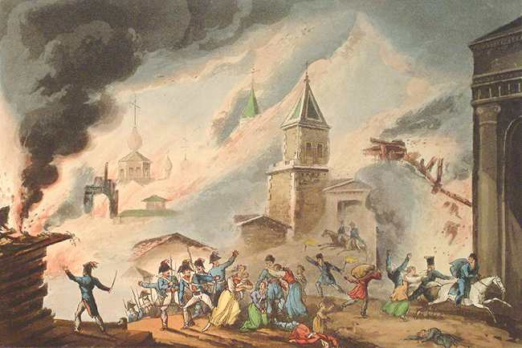
The “Big Blunder” – Russia
(1812-1813)
My army’s retreat from Spain came on the heels of the Russian Campaign
In July, 1812 I led my Grand Army of 614,000 men eastward across central Europe and into Russia
The Russians avoided a direct confrontation with me (cowards)
They retreated to Moscow, drawing our troops into the interior of Russia [hoping that it’s size and the weather would act as “support” for the Russian cause]
The Russian nobles abandoned their estates and burned their crops to the ground, leaving the French to operate far from their supply bases in territory stripped of food
That winter proved to be the harshest my army and I had ever witnessed
September 14, 1812 → we reached Moscow, but the city had largely been abandoned
The Russians had set fire to the city
Moscow on Fire!
Courtesy of Google Images)

Slide 7
Summary of My Experience in Russia
Tsar Alexander I withdrew from the our French alliance because of the unpopularity of the Continental System and Grand Duchy of Warsaw
I once again assembled the Grande Armée from 20 nations (almost 600,000 soldiers) to invade Russia in 1812
Russians abandoned Moscow and used the scorched-earth policy when retreating to starve my Grande Armée.
It worked- So I pulled out in October, 1812
Of my original nearly 600,000 soldiers, only 20,000 survived the cold, hungry trek back across Eastern Europe (the rest died or deserted)

Slide 8
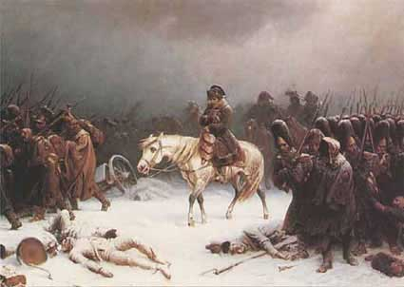
My Retreat from Moscow (Early 1813)
Retreat from Russia
Courtesy of Google Images
Watch to witness the terrors that we witnessed:
https://www.youtube.com/watch?v=2z_w_5M4FBg

Slide 9
The 6th Coalition
My
(Napoléon’s)
Defeat
1813-1814:
France →
← Britain, Russia. Spain, Portugal, Prussia, Austria, Sweden, smaller German states
Battle of Dresden (Aug., 26-27, 1813)
Coalition vs. My Army
My forces regrouped with Polish reinforcements
100,000 coalition casualties; 30,000 French casualties.
French victory
I may have won this battle, but the signal of my final defeat was approaching rapidly

Slide 10
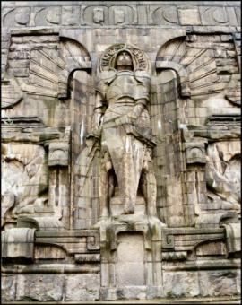
My Defeat at Leipzig (October 16-19, 1813)
Also called Battle of the Nations
Was a decisive defeat of mine, resulting in the destruction of what was left of French power in Germany and Poland
Fought at Leipzig, in Saxony against coalition
French were defeated
This battle, one of the most severe of my Napoleonic Wars, marked the end of the French Empire east of the Rhine
Battle of the Nations Memorial
Courtesy of Google Images

Slide 11
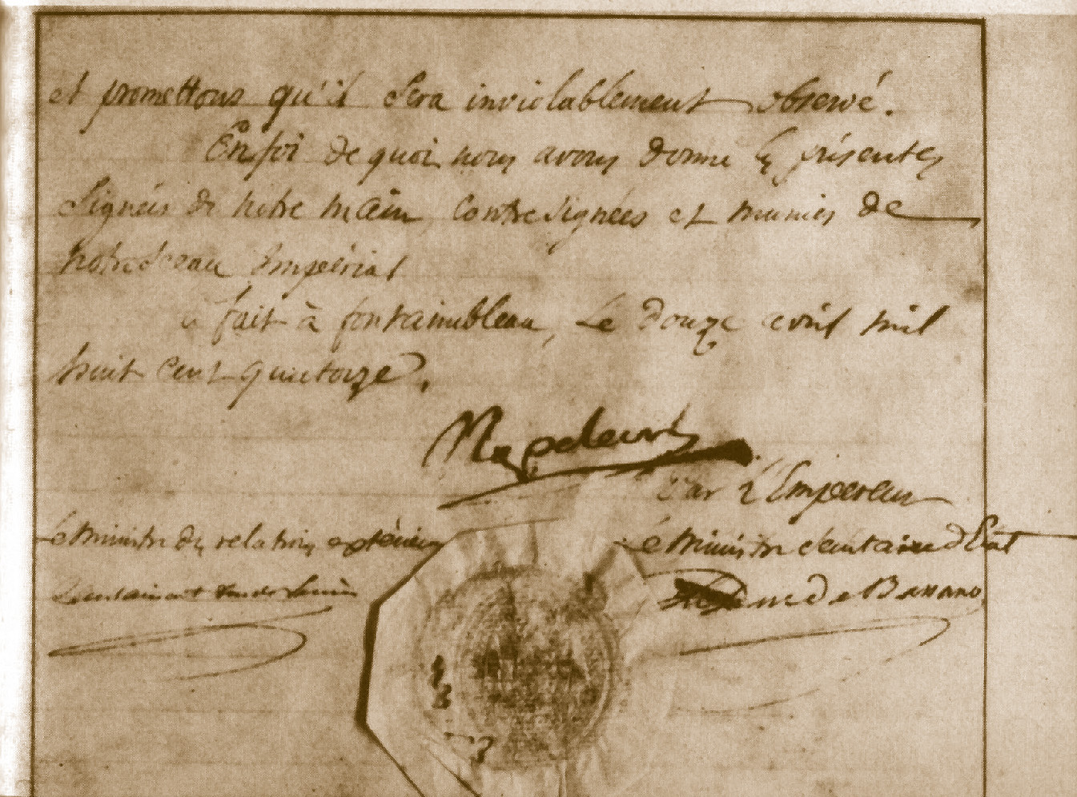
My Abdication
Allied forces occupied Paris on March 31, 1814
I am abdicated on April 6 in favor of my son, but the Allies insisted on unconditional surrender
I am abdicated again on April 11!!!
Treaty of Fontainebleau exiles me to the island of to Elba with an annual income of 2,000,000 francs
The royalists took control and restored Louis XVIII to the throne, who, in my opinion, was completely unqualified for the job
Background Image
“Napoleon’s Abdication”
Courtesy of Google Images

Slide 12
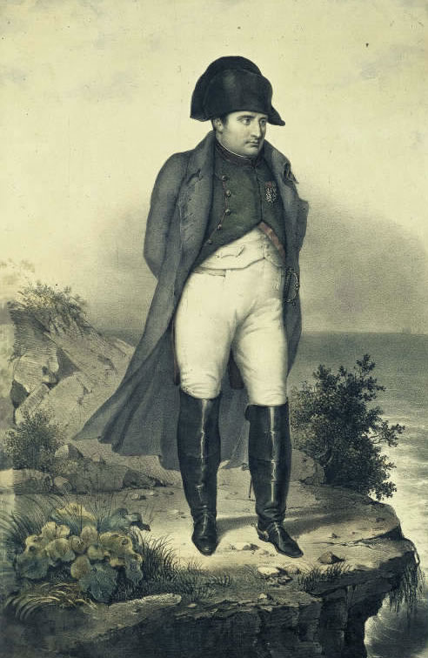
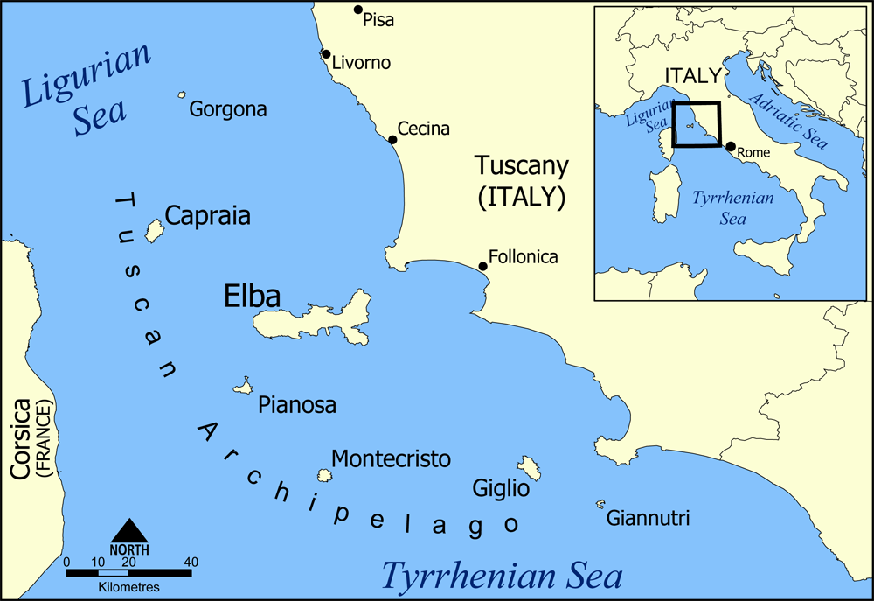
Me in Exile on Elba
I ruled the little government that they had on the island, but I could not take much of it, France was in need of it’s ruler and he had to return and revive the country!
Napoleon on Elba and Map of NW Italy
Images Courtesy of Google

Slide 13
The
"Hundred Days"
(March 20 - June 22, 1815)
I escaped Elba and landed in France on
March 1, 1815
This marked the beginning of my 100 Days.
My wife, Marie Louise, & son were in the hands of the wretched Austrians
OVERVIEW
March 20, 1815: I marched triumphantly into Paris
June 18, 1815: Battle of Waterloo (in Belgium)
I am defeated: Exiled to St. Helena in the South Pacific

Slide 14
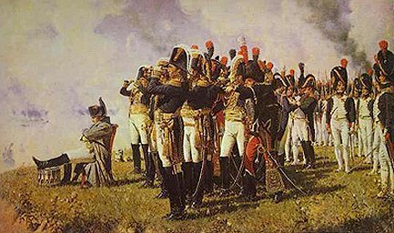
Napoleon’s Small Troops during the 100 Day Campaign
Courtesy of Google Images
“The War of the 7th Coalition”
My
(Napoleon’s) “100 Days”
← 7th coalition Britain, Russia. Prussia, Austria, Sweden, smaller German states
1815:
France →

Slide 15
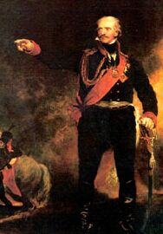
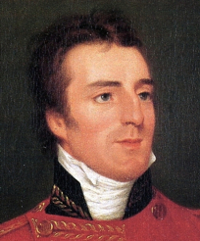
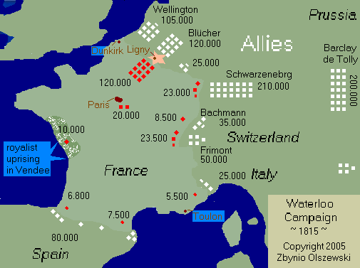
My Defeat at Battle of Waterloo (June 18, 1815)
Duke of Wellington
Courtesy of Google Images
Prussian General Blucher
Courtesy of Google Images
Battle of Waterloo: fought Sunday, 18 June 1815 near Waterloo in present-day Belgium
Imperial French army under the command of myself (Napoleon) was defeated by the armies of the Seventh Coalition under the command of the Duke of Wellington combined with a Prussian army under the command of Gebhard von Blücher
It was the culminating battle of the Waterloo Campaign and my last ever
The defeat at Waterloo consequently ended my rule as Emperor of the French, marking the end of my Hundred Days return from exile

Slide 16
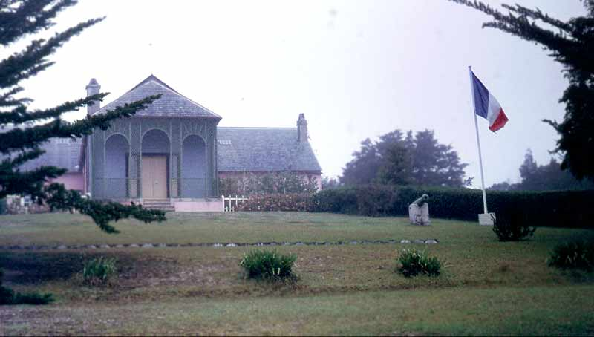
On My Way to My Final Exile on St. Helena
Here is where I marked down my greatest conquests and life’s story in my journal. I even rewrote some of my strategies.
Found in :The Corsican: A Diary Of Napoleon's Life In His Own Words
Excerpt from his journal:
“In reality there is nothing really noble or base in this world.... Frankly, I am base, essentially base. I give you my word, that I should feel no repugnance to commit what would be called by the world ‘a dishonourable action’ ” (Napoleon 32).
Right: Napoléon going to St. Helena
Left: Residency at St. Helena
Both Images Courtesy of Google Images

Slide 17
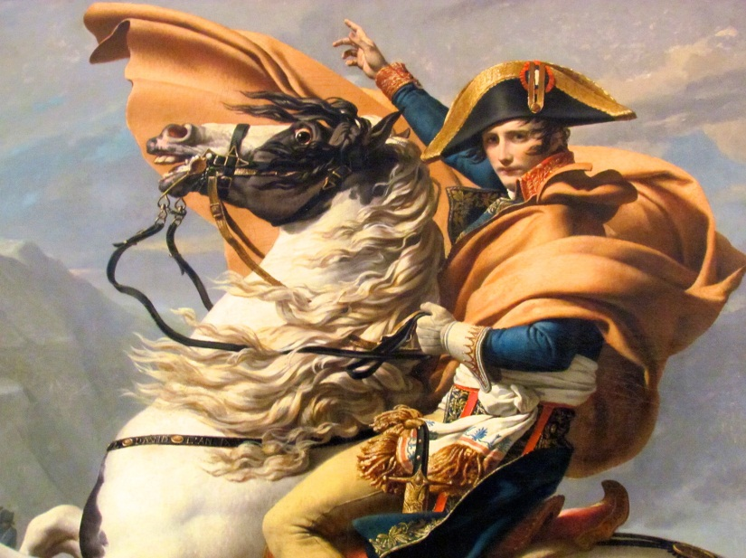
The Legacy of Napoleon Bonaparte (1769-1821)
Controversial historical figure
Pros
Established meritocracy
Held plebiscites
Spread revolutionary ideals
Expanded French territory
Cons
Absolute ruler
Ruled an empire with puppet kings
Took away many rights of women
International legacy
Destruction of the Holy Roman Empire led to the creation of Germany
1803 – Sold the Louisiana Territory to the United States
Created nationalistic fervor throughout the world
Young Napoléon
Courtesy of Google Images
Recommended further viewing:
https://www.youtube.com/watch?v=5DvvNwxoLQs

Slide 18
Works Cited
Abbott, John. Life of Napoleon Bonaparte. N.p.: Kessinger, 2005. Print.
Balcombe Abell, Lucia Elizabeth. Recollections of the Emperor Napoleon. N.p.: J. Murray, 1845. Print.
Chambers, Mortimer. The Western Experience 9th Edition. New York: Knopf; [distributed by Random House, 2003. Print.
"Google Images." Google Images. N.p., n.d. Web. 14 Dec. 2012.
Napoleon, and R. M. Johnston. The Corsican; a Diary of Napoleon's Life in His Own Words ... Boston: Houghton Mifflin, 1910. Print.
"Napoleon Bonaparte." UPenn.edu. N.p., n.d. Web. 10 Dec. 2012.
Schom, Alan. Napoleon Bonaparte. New York, NY: HarperCollins, 1998. Print.
Sherman, Dennis, and Joyce E. Salisbury. The West in the World: A Mid-length Narrative History. Boston: McGraw-Hill, 2001. Print.
Zamoyski, Adam. 1812: Napoleon's Fatal March on Moscow. London: HarperCollins, 2004. Print.

